Slide 1
Tillamook Bay Community College Strategic Planning
All Staff Project Kick-off: November 19, 2021

Slide 2
Launching TBCC’s Strategic Planning Process
Why Strategic Planning? Why now?
How can you play a role?
2
Notes:
How can you play a role:
Initial input on challenges, opportunities and priorities today
Survey and focus group participation (self nominate or nominate others)
Provide ,ideas, contacts and connections for our community/stakeholder outreach to ensure
Feedback on drafts along the way
Supporting a successful implementation of the plan

Slide 3
TBCC Strategic Planning Committee Members
Tom Atchison – Business Administration Faculty
Holly Kraus – Support Specialist in Instruction
Heidi Luquette – Executive Director of Advancement/Foundation
Erin McCarley – Director of Institutional Effectiveness
Kellie McKeehan – Student Engagement Facilitator
Sara Mustonen – Student Success Coach
Teresa Rivenes – Vice President of Instruction
Jude Schlotzhauer – Welding Instructor
3

Slide 4
About Coraggio Group

Slide 5
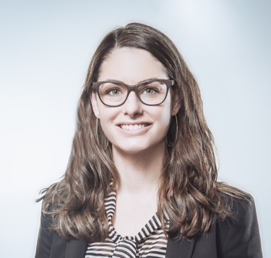
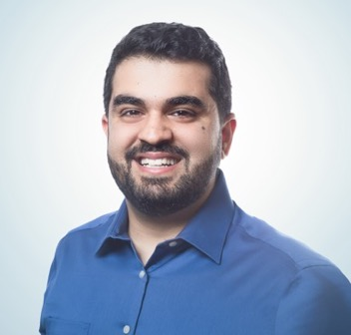
Your Core Coraggio Team Members
Sarah Lechner, Associate Principal and TBCC Project Manager)
Stakeholder engagement
Strategic planning process leadership
5 years at Coraggio
M.A., Leadership and Organizational Development
B.A., Environmental Studies
PROSCI Change Management certified
Yahya Haqiqi, Senior Business Analyst
Stakeholder engagement
Survey and data analysis
3 years at Coraggio
B.A., Leadership, Management and HR Management

Slide 6
Strategic Planning Frameworks
& Process Overview
6

Slide 7
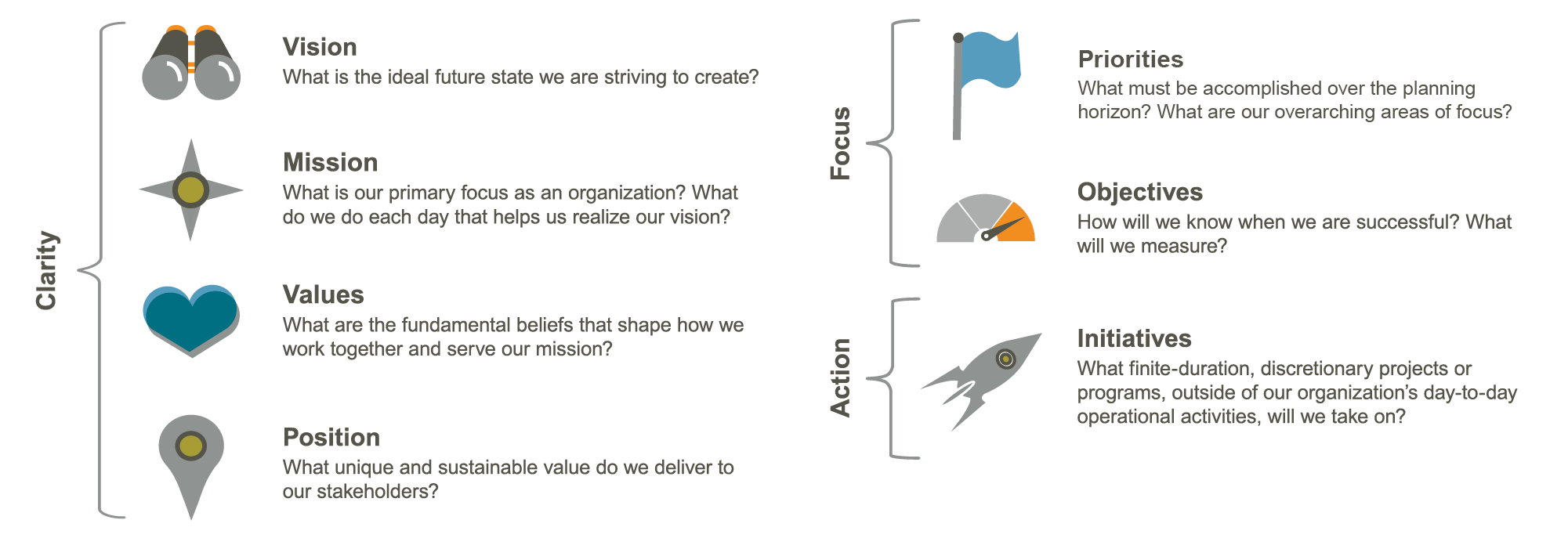
Strategic Planning Framework
7
Notes:
Priorities

Slide 8
8

Slide 9
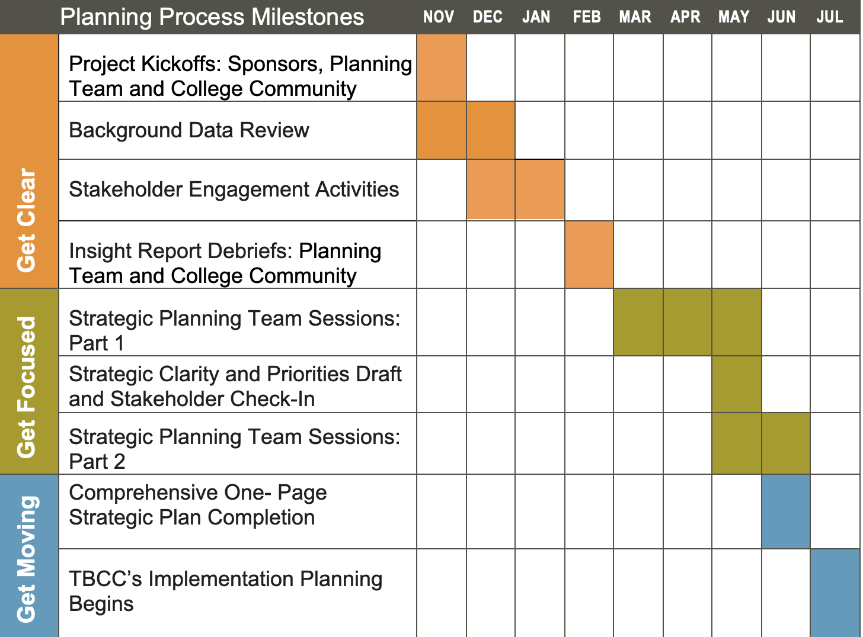
Project Phases
and Timeline
9

Slide 10
Breakout Group Discussions
10

Slide 11
11

Slide 12
Small Breakout Group Discussions
What strategic challenges or community/college needs does our plan need to address?
What strategic opportunities do we need to seize?
Given this, how might our Strategic Priorities shift?
Current Core Themes (Priorities) are:
Educational Excellence
Economic Success
Leadership Partnership and Community Engagement
Any guidance for the Leadership Team or Planning Committee as we embark on this strategic planning process?
Group Agreements
1. Step up & step back 2. Allow for different perspectives 3. Confidentiality
12
Notes:
Step up & step back
(Explain: Speak up and also create space for others. Be aware of how often and how much you are speaking. We won’t likely be able to hear from every person on every question.)
Allow for different perspectives
(Explain: Be open and curious and take this as an opportunity to learn about how others’ experiences or perspectives may differ from your own.)
Confidentiality
(Explain: What is shared here stays here.)

Slide 13
Group Report Outs
Breakout Group Facilitators:
Chris Carlson, Faculty Representative, Math Dept.
Rhoda Hanson, Vice President of Student Services
Heidi Luquette, Executive Director of Advancement/TBCC Foundation
Erin McCarley, Director of Institutional Effectiveness
Sheryl Neu, Director of Information Technology
Teresa Rivenes, Vice President of Instruction
Pat Ryan, Director of Facilities, Safety and HR
Ross Tomlin, President
Kyra Williams, Vice President of Finance
13

Slide 14
Questions?
14

Slide 15
Upcoming Next Steps
Communications and All Staff Meeting
Planning Committee Kickoff
Survey
Focus Group and Interview Outreach

